Slide 1

C++ Beginner Tutorial:
Functions IV
Recursion

Slide 2
What is recursion?
A property of function to be able to call itself…
Get factorial of a given number:
  Factorial of n = 1*2*3*…..*(n-1)*n
  Factorial of 5 = 1*2*3*4*5=120
Generate Fibonacci sequence
  1, 1, 2, 3, 5, 8, 13, 21…………………….

Slide 3
How to write a recursive function
Create a function
Make a call to itself
Make sure you have a exit case
  We don’t want any infinite loop here

Slide 4
Code Examples
Factorial Code – Simple
  Explanation
Fibonacci Code – Complex
  Explanation

Slide 5
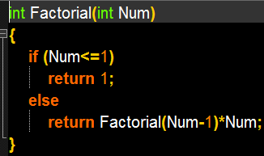
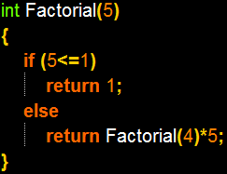
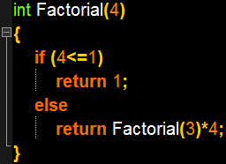
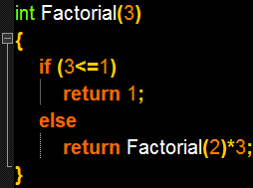
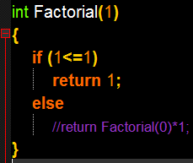
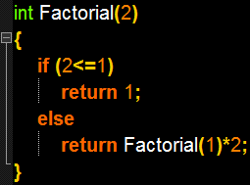
Factorial Explanation with n=5
Return 6*4=24
Return 2*3=6
Return 1*2=2
Return 24*5=120
120
Return 1

Slide 6
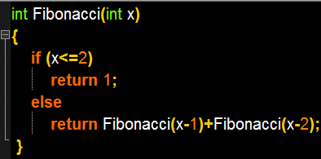
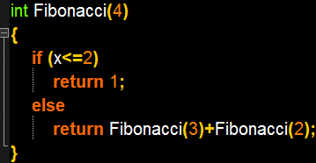
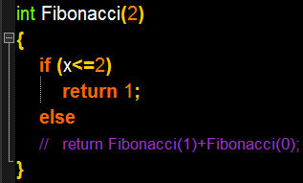
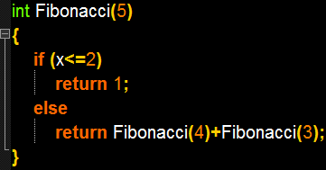
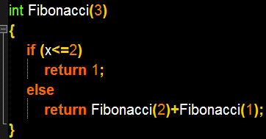
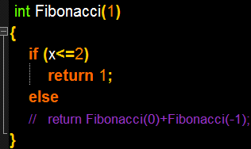
Fibonacci example: n=5
Return 1
Return 1
5
Return 1+2=3
Return 1+1=2
Return 3+2=5
Return 1
Return 1+1=2

Slide 7
Thank you for watching…
Next: Intermediate C++
Please visit http://www.digitalstage.org

