Slide 1

C++ Beginner Tutorial:
Functions III
Pass By Value
Pass By Reference

Slide 2
In This Video
Functions:
  Pass by reference
  Pass by value

Slide 3
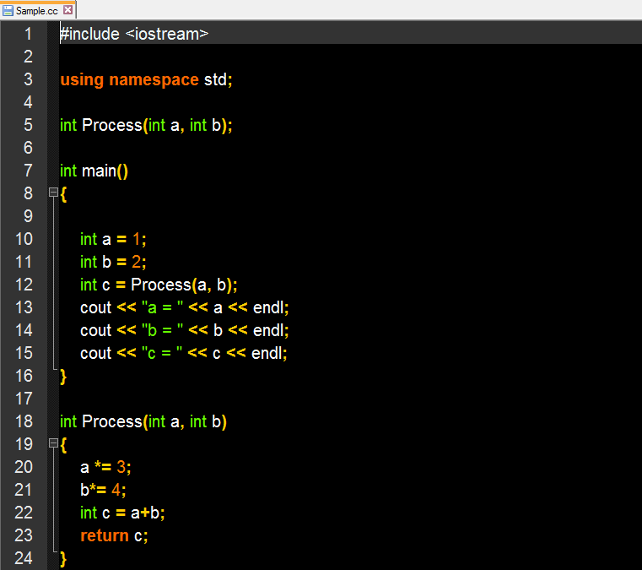
A simple C++ program with function:
Pass by value

Slide 4
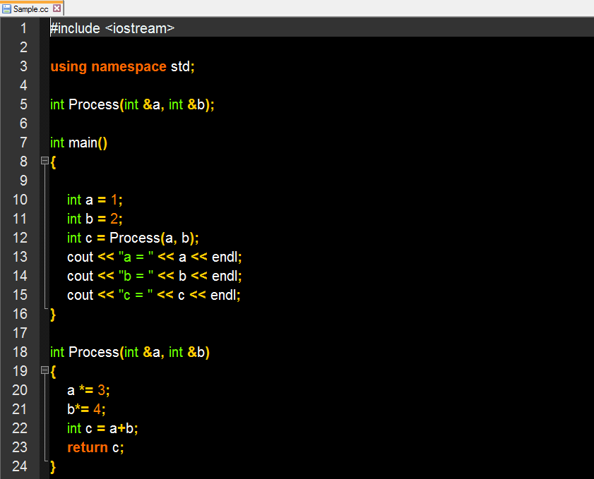
A simple C++ program with function:
Pass by Reference

Slide 5
Let’s see the output…

Slide 6
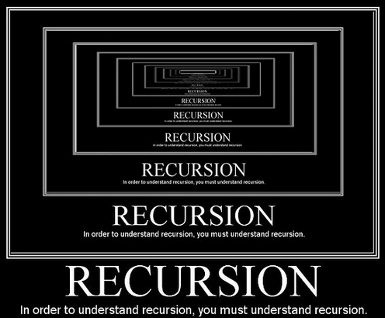
Next Video: Recursion

